Slide 1
Affinity Propagation
Affinity Propagation is a clustering algorithm that identifies exemplars among data points.
Unlike k-means, it does not require specifying the number of clusters beforehand.
It is based on message passing between data points.

Slide 2
How it works?
Each data point is considered as a potential exemplar.
Responsibility and availability messages are exchanged iteratively.
Converges to find exemplars and form clusters.
It does not require predefined clusters.
It will find representative exemplars automatically.

Slide 3
Affinity propagation applications
Image segmentation
Bioinformatics
Document clustering
Benefits
Does not require predefined clusters.
Finds representative exemplars automatically.
Works well with non-Euclidean distances

Slide 4
Mean shift
Mean shift is a non-parametric clustering algorithm that finds dense regions in data.
It does not requires specifying the number of clusters.
It moves the data points iteratively towards the highest density area.

Slide 5
How does it works?
It selects the random points and calculates the density using a kernel.
It moves points towards the highest density region iteratively.
It stops when convergence is reached.
We need to predefine clusters and works with complex cluster shapes.
It is effective in density based clustering.

Slide 6
Mean shift Applications
Image segmentation
Object tracking
Anomaly detection
Benefits
No need to predefine clusters.
Works well with complex cluster shapes.
Effective in density-based clustering.

Slide 7
Spectral Clustering
A clustering algorithm that uses graph theory to partition data.
Converts data into a similarity graph and applies eigenvector decomposition.
Useful for non-linearly separable data.

Slide 8
Step 1: Construct a similarity graph.
Step 2: Compute the Laplacian matrix.
Step 3: Perform eigenvalue decomposition.
Step 4: Apply k-means clustering on eigenvectors.

Slide 9
Spectural clustering real world applications
Image segmentation
Social network analysis
Bioinformatics.
Benefits
Works well for complex and non-linearly separable data.
Handles arbitrary cluster shapes.
Uses global structure for clustering.

Slide 10
DBSCAN
Density-Based Spatial Clustering of Applications with Noise (DBSCAN).
The DBSCAN algorithm views clusters as areas of high density separated by areas of low density
Groups data based on density, identifying core, border, and noise points.
Useful for discovering clusters of arbitrary shapes.

Slide 11
Step 1: Select a random point and check its neighbors.
Step 2: Expand the cluster if density criteria are met.
Step 3: Mark noise points that don’t belong to any cluster.
Step 4: Repeat until all points are classified.

Slide 12
DBSCAN real world applications
Anomaly detection
Spatial data analysis
Customer segmentation.
Benefits
No need to specify the number of clusters.
It will Handles noise and outliers well.
It detects clusters of arbitrary shape.

Slide 13
.
HDBSCAN
Hierarchical Density-Based Spatial Clustering of Applications with Noise (HDBSCAN).
The HDBSCAN algorithm can be seen as an extension of DBSCAN and OPTICS
Specifically, DBSCAN assumes that the clustering criterion (i.e. density requirement) is globally homogeneous.
DBSCAN may struggle to successfully capture clusters with different densities
HDBSCAN alleviates this assumption and explores all possible density scales by building an alternative representation of the clustering problem.
Extends DBSCAN by analyzing cluster stability and hierarchy.
Automatically determines the number of clusters.

Slide 14
Step 1: Construct a mutual reachability graph.
Step 2: Apply single-linkage clustering.
Step 3: Condense the hierarchy to extract stable clusters.
Step 4: Assign soft clustering probabilities.

Slide 15
HDBSCAN real world applications
Customer segmentation
Anomaly detection
Geospatial data analysis
Benefits
No need to specify the number of clusters.
Handles varying densities of clusters.
Identifies noise and outliers effectively.

Slide 16
.
OPTICS
Ordering Points To Identify the Clustering Structure (OPTICS).
Similar to DBSCAN but produces a hierarchical clustering structure.
Useful for identifying clusters with varying densities.

Slide 17
Step 1: Compute the reachability distance for each point.
Step 2: Process points in increasing order of reachability distance.
Step 3: Generate a reachability plot to visualize clusters.
Step 4: Extract clusters from the reachability plot.

Slide 18
Optics real world applications
Geospatial data analysis.
Anomaly detection.
Customer segmentation.
Benefits
Handles clusters of varying densities.
Generates a hierarchical clustering structure.
No strict requirement to define the number of clusters.

Slide 19
.
BIRCH
BIRCH (Balanced Iterative Reducing and Clustering using Hierarchies) is a hierarchical clustering algorithm.
Efficient for large datasets.
Uses a tree structure called the CF Tree.

Slide 20
Step 1: Build a CF Tree by scanning the dataset.
Step 2: Compress the tree to remove outliers.
Step 3: Apply a clustering algorithm (e.g., k-means).
Real-World Applications of BIRCH Clustering
Used for customer segmentation in marketing.
Helps in image compression.
Applied in anomaly detection in large-scale datasets

Slide 21
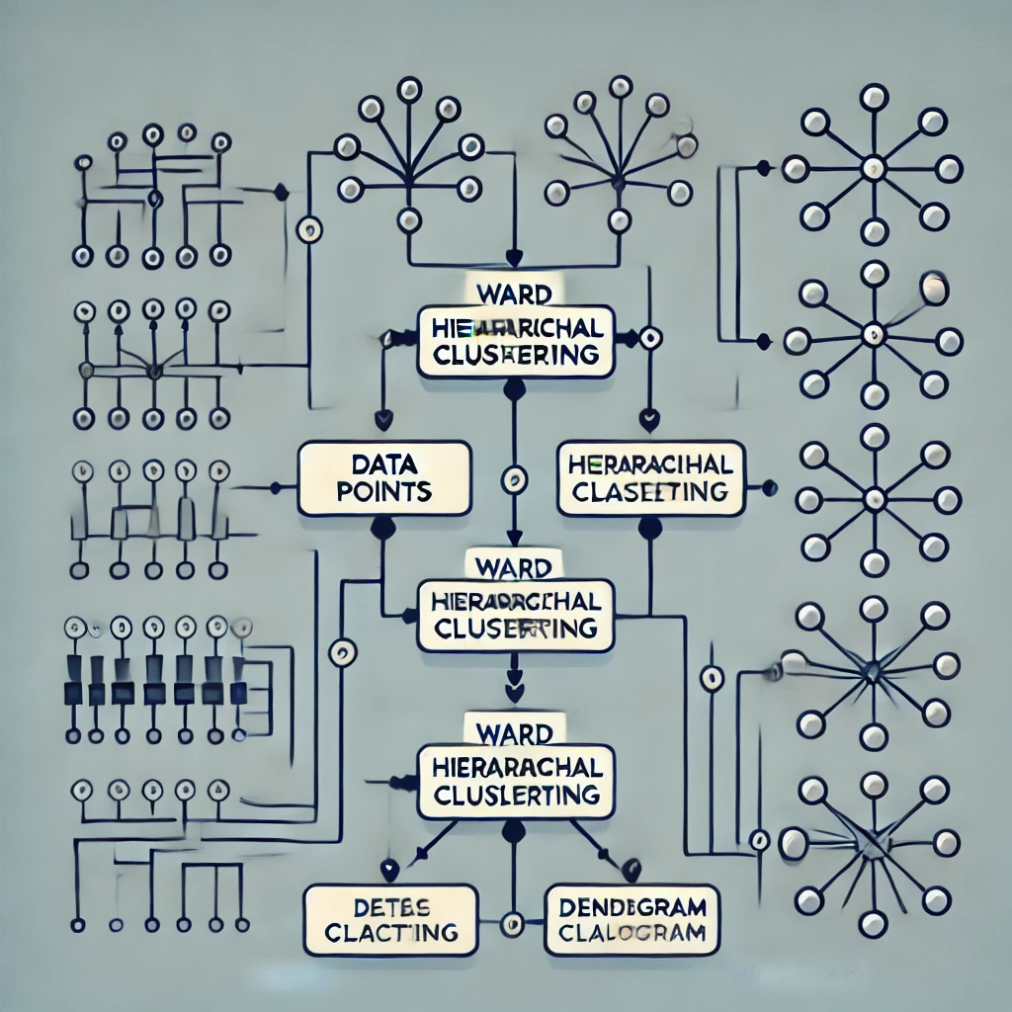
.
Hierarchical Clustering
A hierarchical clustering method that minimizes variance within clusters.
Merges clusters step-by-step to form a dendrogram.
Often used in data segmentation and image processing.

Slide 22
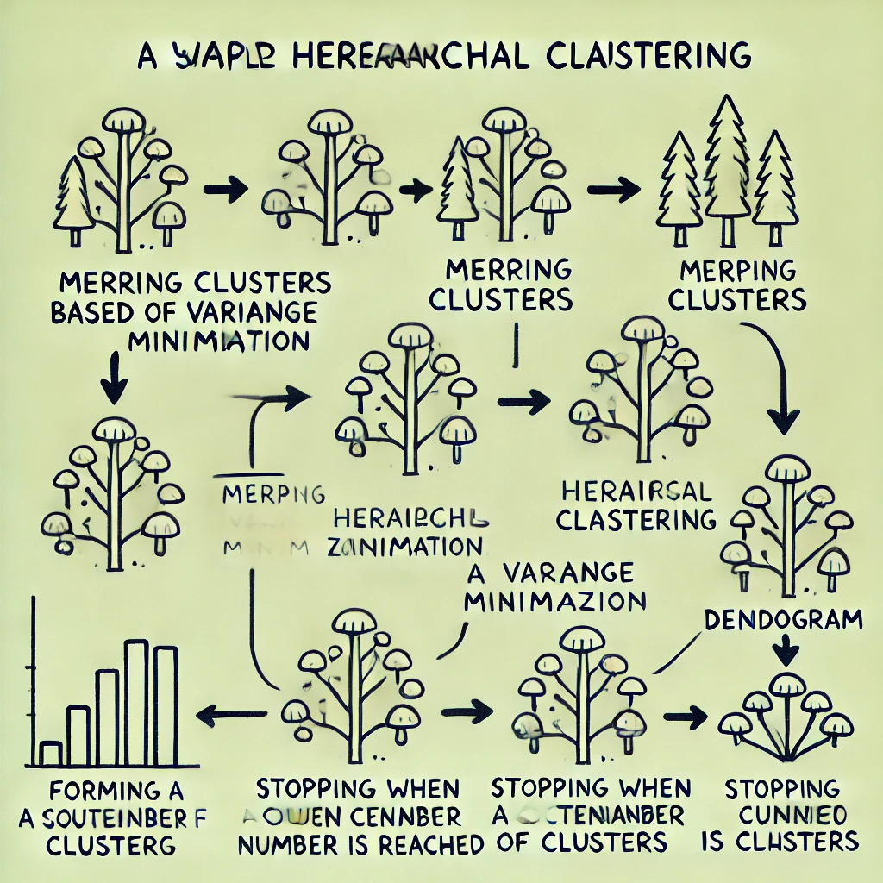
Minimizes Variance – It merges clusters by minimizing the increase in variance, leading to more balanced and meaningful clusters.
Creates a Hierarchy – Generates a dendrogram that allows for analysis at multiple levels of granularity.
No Need to Predefine Clusters – Unlike K-Means, it does not require specifying the number of clusters in advance.
Handles Various Data Types – Can be used on numerical, categorical, or mixed data types.
Useful for Small to Medium Datasets – Works well with moderate-sized datasets where hierarchical relationships are important.

Slide 23
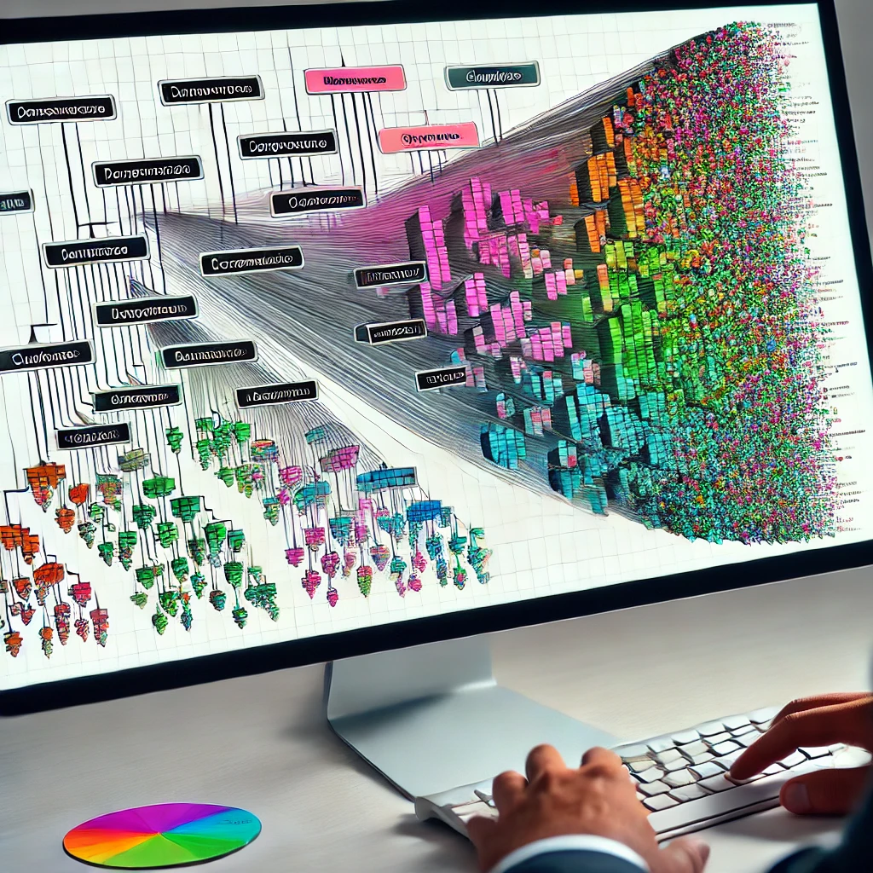
.
Hierarchical Clustering
Hierarchical clustering real world applications
• Customer segmentation in marketing.
• Image segmentation in computer vision.
• Grouping similar documents in text analysis

Slide 24
THANK YOU

